Slide 1
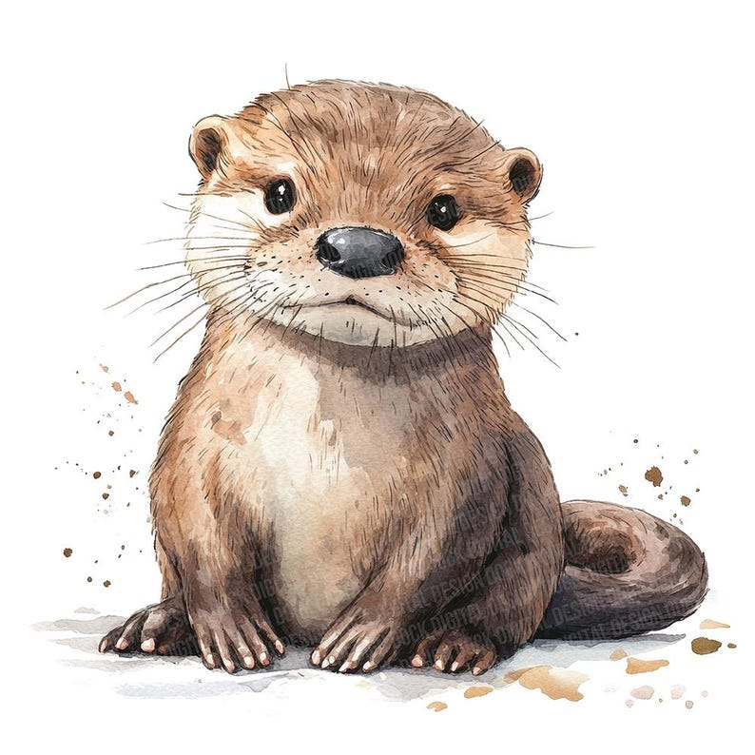
Welcome to Otter Class
Year 3

Slide 2

Otter Class Staff:
Teachers:
Mrs Kalek- Monday and Tuesday
Mrs Crawley- Wednesday, Thursday and Friday
TAs:
Mrs Taylor Monday, Tuesday, Wednesday and Friday
Mrs Hayers on Thursday

Slide 3
School Day:
Arrive for 8:40. Children arrive put lunch/ water bottle/ bag/ reading books etc away and begin morning work
Register closes at 8:50
The gate will open just before 08:40 and close just before 08:50.
Late arrivals after 08:50 will need to be signed in at the office.
Unauthorised lateness will be recorded from 09:00, with authorised lateness accepted between 08:50-09:00 with a clear reason.
Lesson 1 begins at 8:50
End of day 3:15, gates close at 3:25 due to clubs starting.
If you are running late (after 3:25) please go to the office.
If someone different is collecting your child, a password must
be given.

Slide 4
Topics covered this year:
Autumn 1 | Autumn 2 | Spring 1 | Spring 2 | Summer 1 | Summer 2
Who first lived in Britain? |  | Extreme Earth – How extreme are volcanoes and earthquakes? | What landmarks are around the World? | What did the Ancient Greeks give the world?
Stone Age Experience Day
Date TBC (in school dress up)
NHM
Oxford
January 2027
Bedford Faith Tour
April 2027
VR Headset Workshop
Date TBC

Slide 5
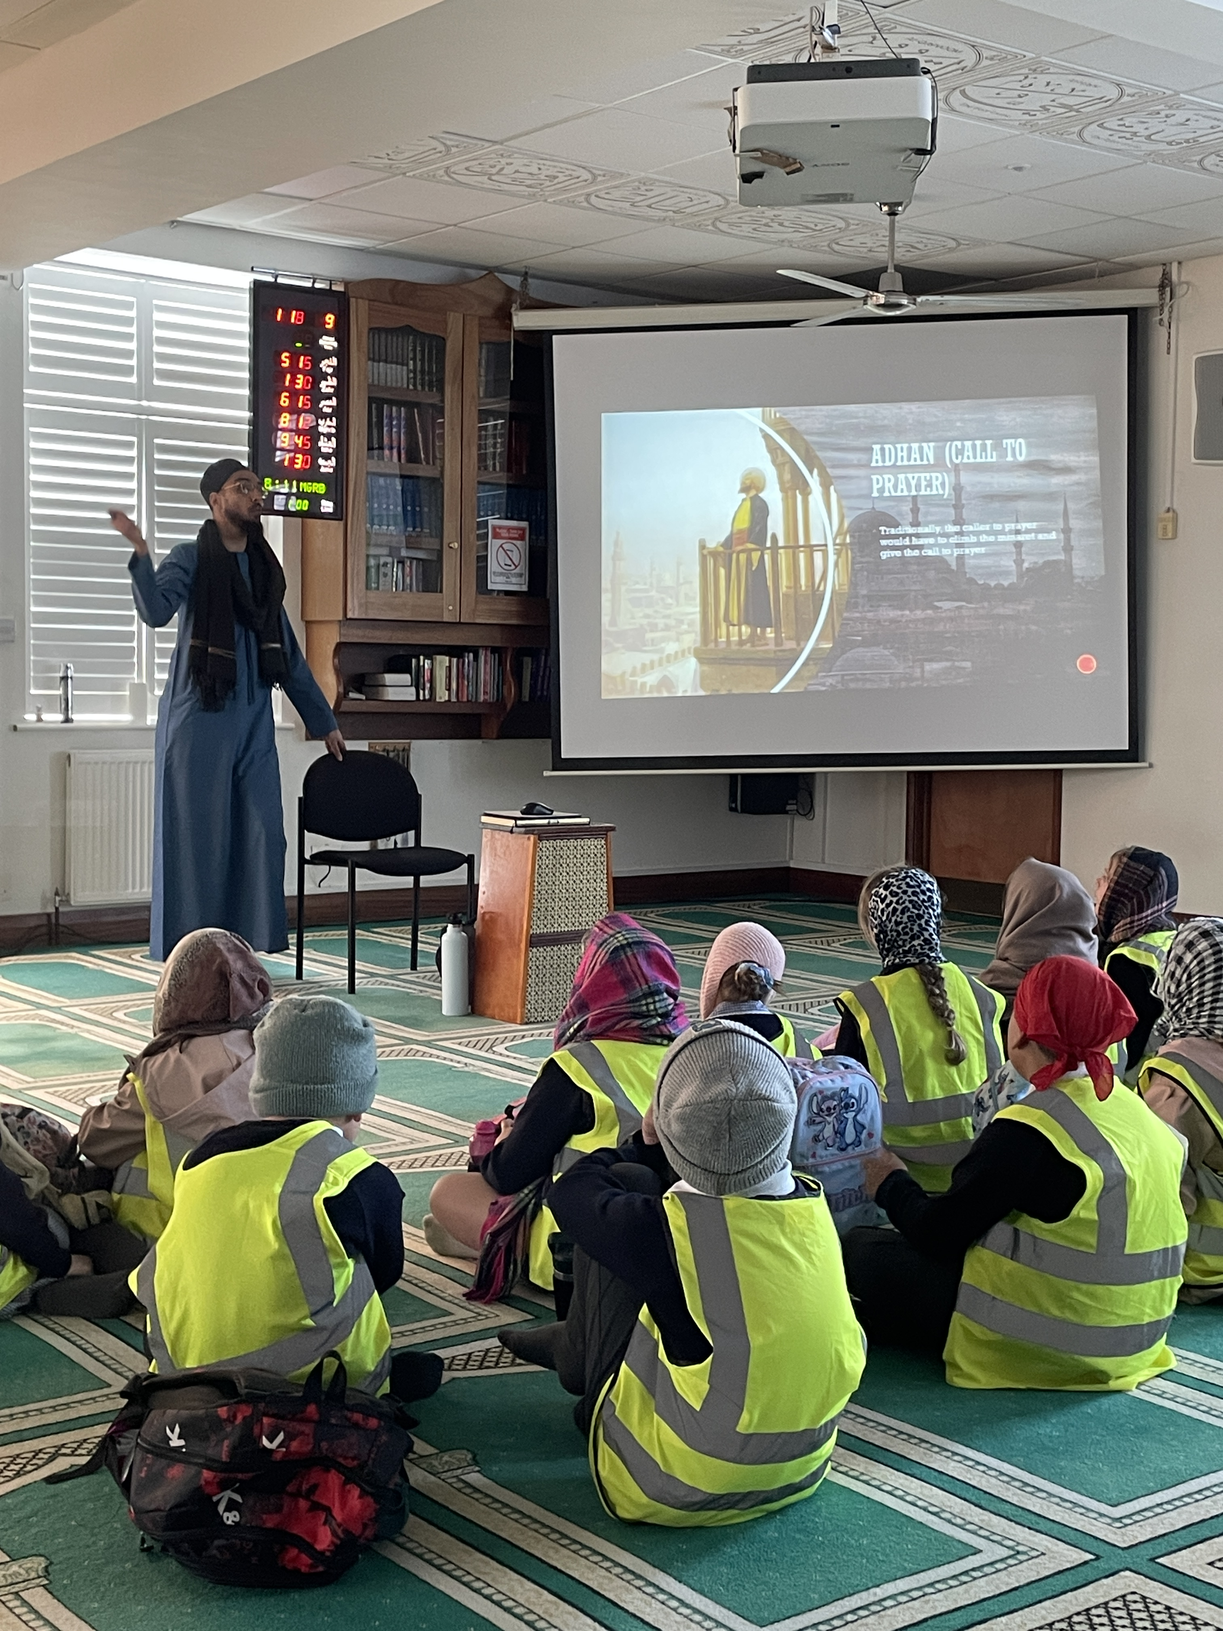
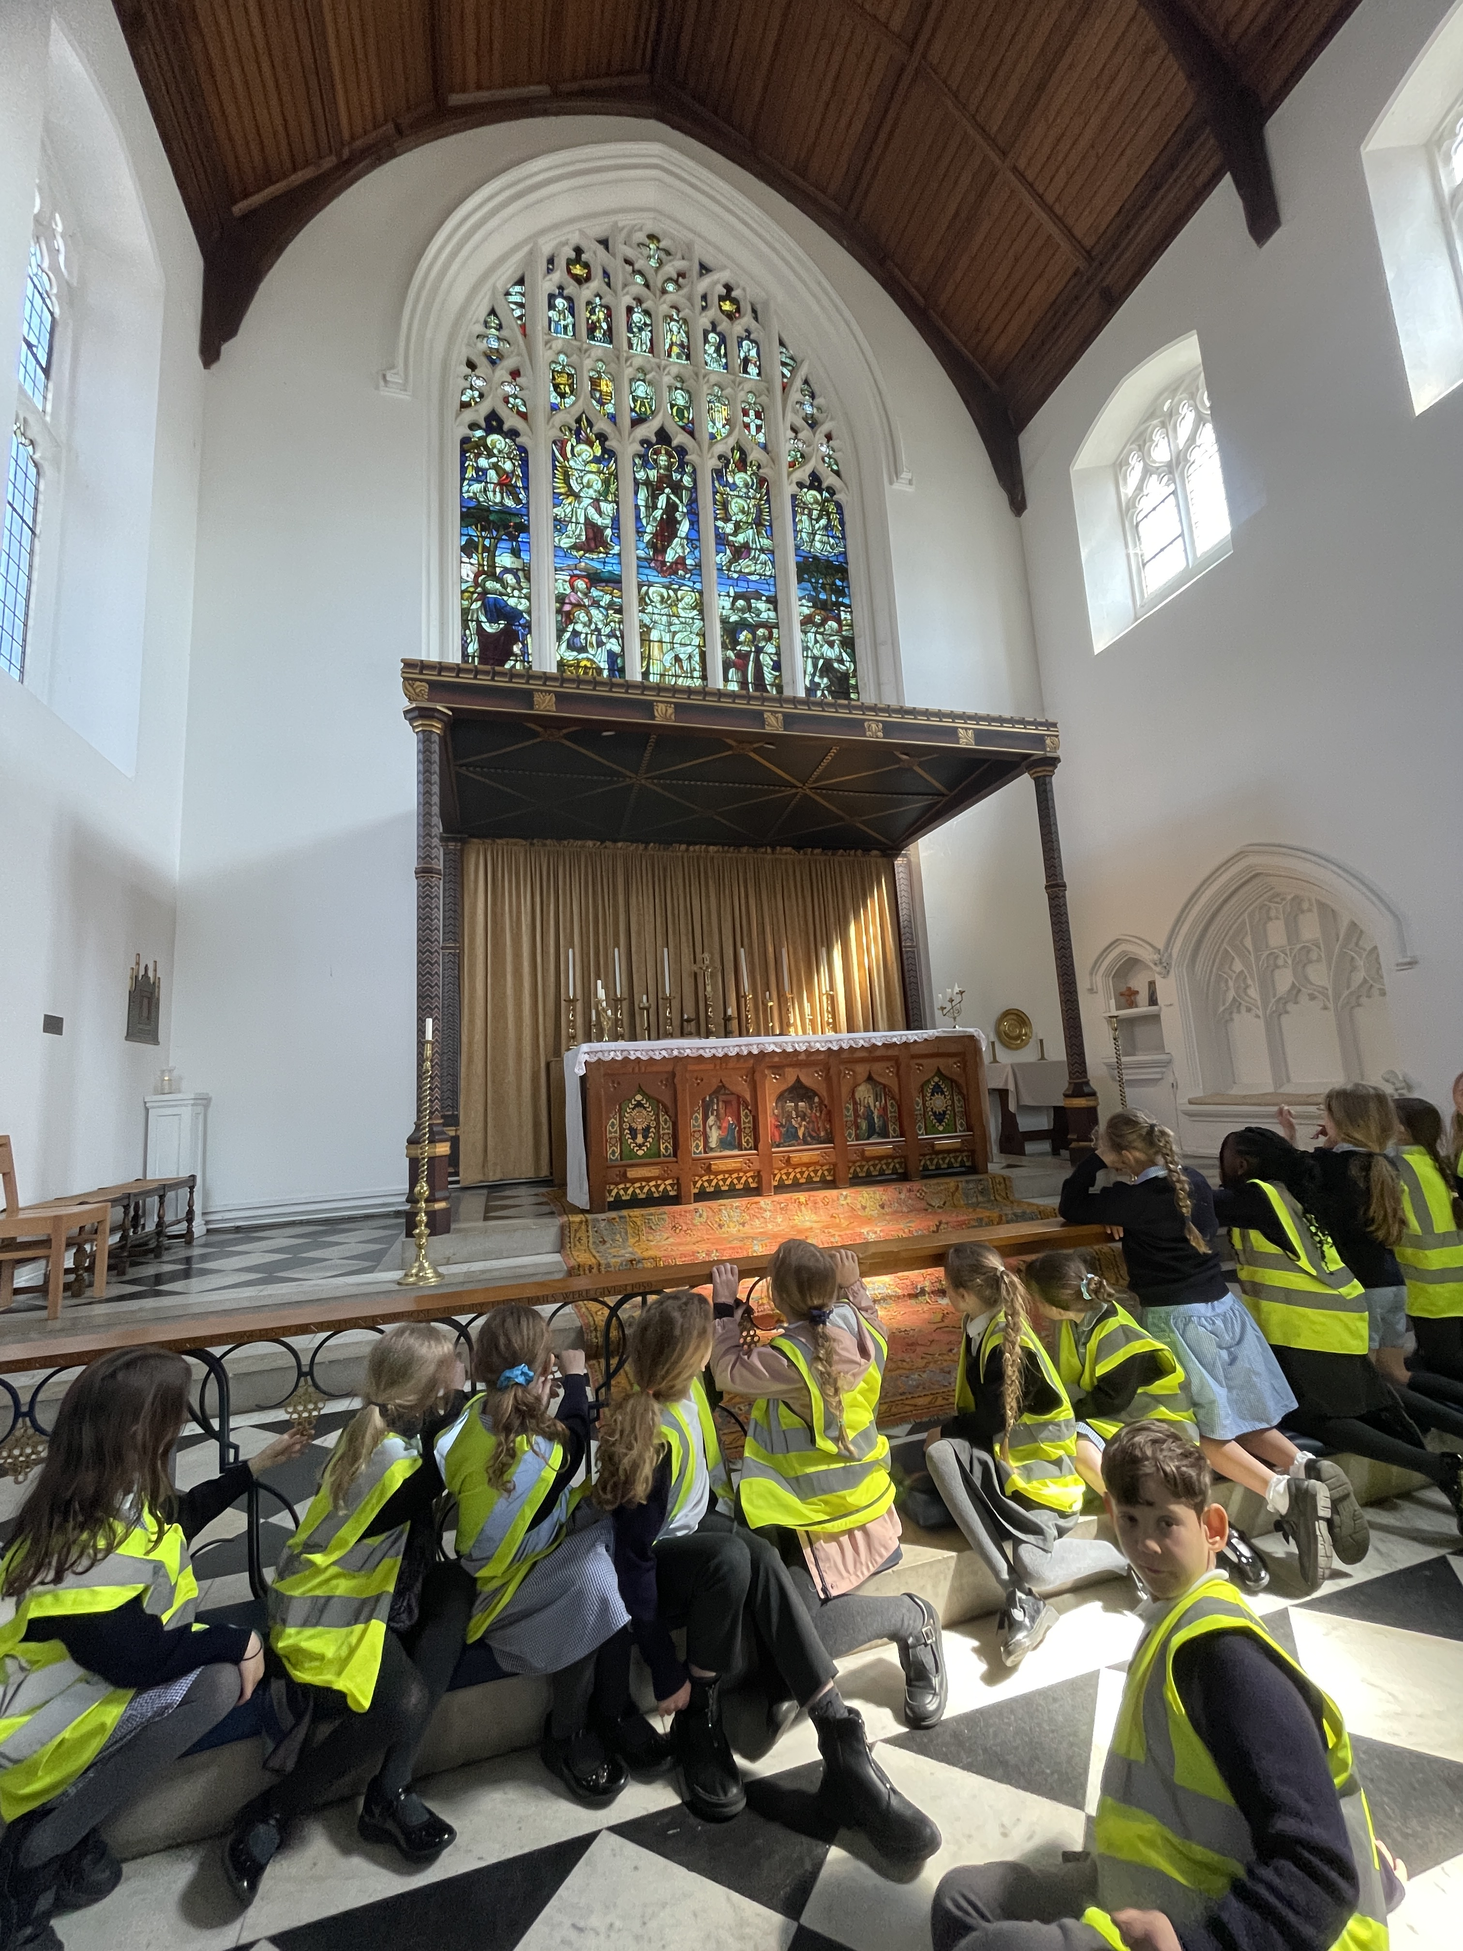
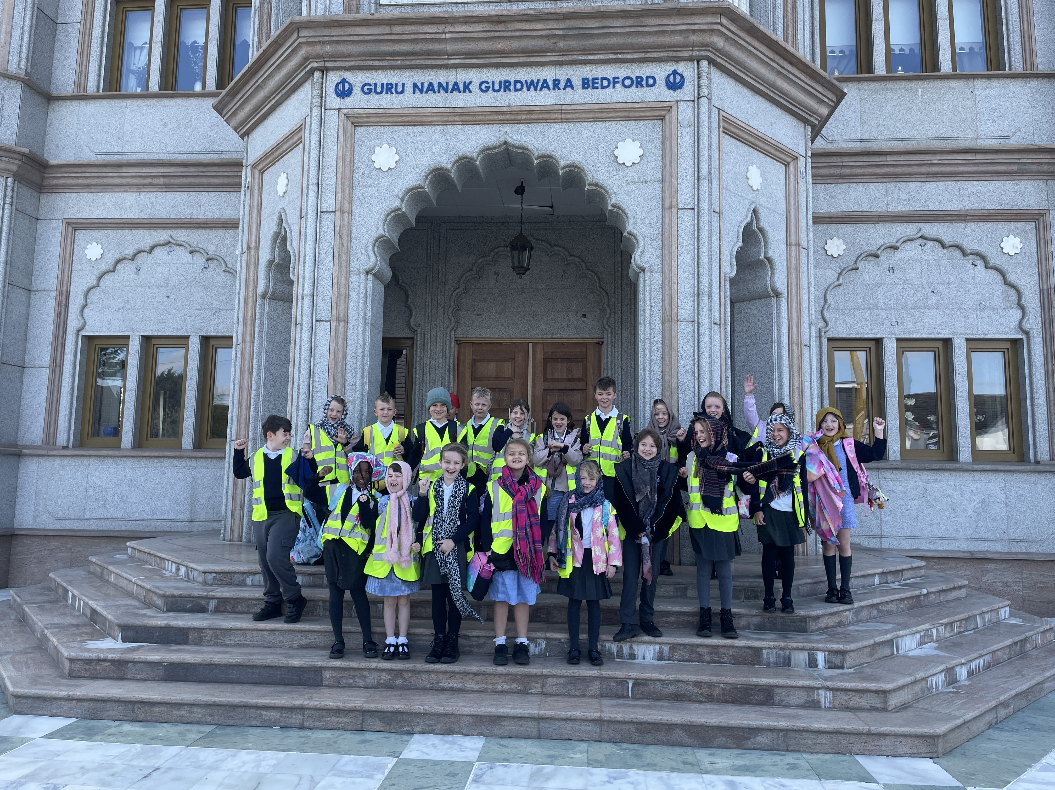
Bedford Faith Tour
This is a wonderful trip during which time we visit three different places of worship. Sikh, Muslim and Christian.
Children will be asked respectfully to remove their shoes and wear a head scarf when we are visiting the gurdwara and the mosque. They will also not be able to have meat in their packed lunch that day.
If you have any questions about the trip please do speak to be directly. I went last year and it was really great to consolidate our learning. All 3 places of worship were incredible; the guides were really welcoming to the children and provided a wonderful age-appropriate presentation during the visit.

Slide 6
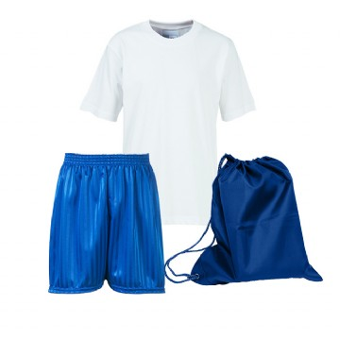
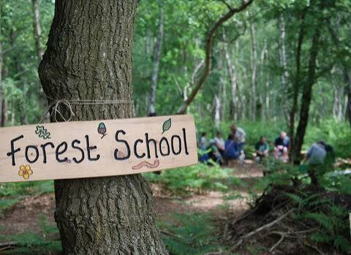
PE :
PE will be on Mondays and Wednesday.
Children come to school dressed in PE kit.
No hoodies, branded sportswear or cycling shorts.
Forest School :
Otter class will take part in Forest School in Spring 2 term.
Long Sleeves
Long trousers
Wellies
Waterproofs!

Slide 7
Home learning:
Topic grids sent home before each half term (also on school website).
We would encourage children to complete 3 tasks of choice
Not compulsory, but children will be rewarded and celebrated for completing tasks ☺
Children can bring them in or email over to year3@newtonlongville.bucks.sch.uk
Time to celebrate what children have created in class.
Reading each day (can be school book, library book or a book at home).
TT Rockstars for multiplication fluency (little and often 3-4 times a week, 10 minute chunks). 7 minutes is the golden number! (21 minutes over the week) Preparation for the statutory test in Year 4.
Spelling passports (in reading diaries and also on school website)

Slide 8
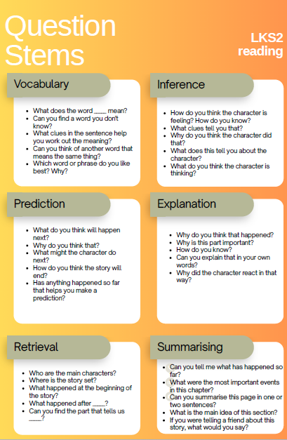
Reading
Research consistently shows that regularly reading with your child is one of the most effective ways to support their learning. Shared reading develops vocabulary, comprehension, and language skills, while also improving children's confidence as readers. Studies have found that children who read and discuss books with adults are exposed to a wider range of words and ideas, helping them achieve more highly across the curriculum.
Even just 10–15 minutes of reading each day can have a significant impact on a child's progress and enjoyment of reading.
The most important thing is not just hearing your child read the words, but talking about what they read. Asking questions, discussing characters, and sharing a love of stories can make a lasting difference to their success as a reader.

Slide 9

Changing books
Books will be changed once a week on a Thursday.
Reading for fluency is important, but also the comprehension of what they are reading.
4 or 5 pages is ideal, as it leaves time to talk about what has happened and discuss new or important vocabulary.
If you complete the book before the book changing day, you are more than welcome to read other books at home and record this in the reading diary. No other books will be provided from school until the following Thursday.

Slide 10

Using AI
We are currently in the process of approving our AI policy with Governors.
In summary, adults and staff are permitted to use a closed AI platform (co-pilot)
Children in KS2 are taught about spotting fake pictures/ images which have been adjusted
They will not be using AI as part of the curriculum
We do not expect AI to be used when completing homework tasks or speeches (house captain etc).

Slide 11
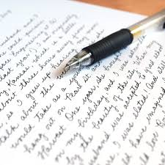
Handwriting
Handwriting lessons x 3 week
Expectation is by the end of year 3 all children will be using a pen (unless stated on a support plan).
All work is completed in pen, except maths.

Slide 12
Spelling scheme
Year 3 spelling passports are green. All children who have completed 90 % of the year 2 words will move onto Year 3 green words.
We teach 3 spelling lessons each week
We re-assess once a term and update the list in the reading diaries

Slide 13
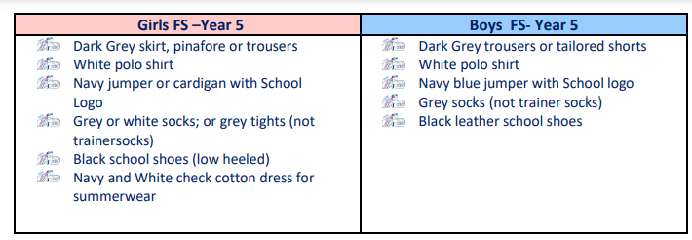
Uniform and equipment:
Water bottles, hat & coat etc.
Fidget toys only if stated on support plans
Healthy snack (fruit etc)

Slide 14

Any Questions?

