Slide 1

Class
Year 2

Slide 2
Class Teacher
Mrs Kwapong
Teaching Assistants
Mrs Hunter
Ms Kalchenko
Mrs Hayers
Mrs Barton

Slide 3
Reading
Research consistently shows that regularly reading with your child is one of the most effective ways to support their learning. Shared reading develops vocabulary, comprehension, and language skills, while also improving children's confidence as readers. Studies have found that children who read and discuss books with adults are exposed to a wider range of words and ideas, helping them achieve more highly across the curriculum.
Even just 10–15 minutes of reading each day can have a significant impact on a child's progress and enjoyment of reading.
The most important thing is not just hearing your child read the words, but talking about what they read. Asking questions, discussing characters, and sharing a love of stories can make a lasting difference to their success as a reader.

Slide 4
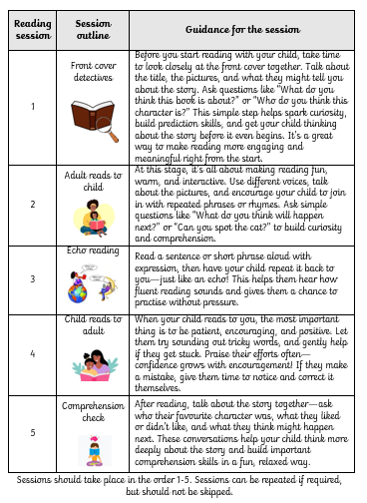

Slide 5


Reading
Your child will get 1 reading scheme book and 1 library book to read at home every week. Please make sure to bring your reading wallets in everyday as sometimes other adults come in and read with the children. (make sure your adult writes in your book so you can have dojos!)
Teachers will keep our own records of children's reading in school and will check your home reading record every week to see all the brilliant reading you’ve been doing! ☺

Slide 6

Changing books
Books will be changed once a week on a Thursday, so that you have plenty of time to work through the sessions 1-5.
If your child completes the sessions before the end of the week, you are more than welcome to read other books together. This can also be recorded in reading diaries.

Slide 7

Early Morning Work
A 10 minute activity to settle children down and prepare them for the day’s learning.
Activities include a spelling/word practise, reading, responding to marking, word searches, phonics games, one to one intervention, colouring or cutting and sticking.
This is why it is important children are in on time.

Slide 8

PE days are Tuesdays and Thursdays. Children are to come in to school in their PE kits.
Appropriate PE Kits
Plain navy Blue shorts (not cycle or gymnastics shorts)
Sky blue t-shirt with logo or Sports sky-blue top with logo
Plain dark sweatshirt (not hoodies)/tracksuit bottoms for colder months outdoor.
PE Trainers
Long hair must be tied back for all physical activities (including boys)
We will also do some daily Activate/Extended Run and Brain Break exercises.

Slide 9

Maths - Mastery Approach following Primary Stars
We will be using lots of practical resources to help children in their maths lessons.
They will be practicing their math fluency every day and doing lots of counting, numbers bonds and times tables.
We will make sure that their math learning is fun and full of real life scenarios so they can see how important these skills are for life.

Slide 10



Writing
This term, we will be reading Dick Whittington, Hansel and Gretel, The Great Fire by Sue Cowling and Crackle Spit by Marie Thom .

Slide 11

Spelling
Red: FS ​
Orange: Year 1​
Yellow: Year 2​

Slide 12

Spelling

Slide 13
Topic– Term 1
In term one, we will be looking at the Great Fire of London and Guy Fawkes (Beyond living memory)
We will be reading a range of fiction and non-fiction books to stimulate ideas for writing.

Slide 14
A.O.B
Label - Jumpers and Cardigans
Water bottles
Fruits
Reading Ambassadors
Eco Councillors
Assessments

Slide 15
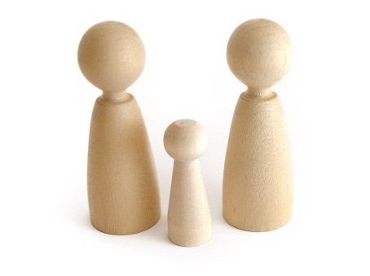
Teacher & Parent Partnership
Partnership with parents is essential for pupils to make maximum progress.
Tell us ….anything which may affect your child’s learning.
We will tell you ….when things are going well and when they are not.

Slide 16

Please send any questions to Mrs Kwapong via the office email address –
year2@newtonlongville.bucks.sch.uk office@newtonlongville.bucks.sch.uk

